Slide 1
Environment setting of ZK and its structure
2018/3/19 by Anna
Notes:
Environment setting of ZK

Slide 2






Combination of ZK
Eclipse
Java
Tools/Server
Language of Program
Tomcat
Javascript
HTML5
Hibernate+Spring
Database

Slide 3
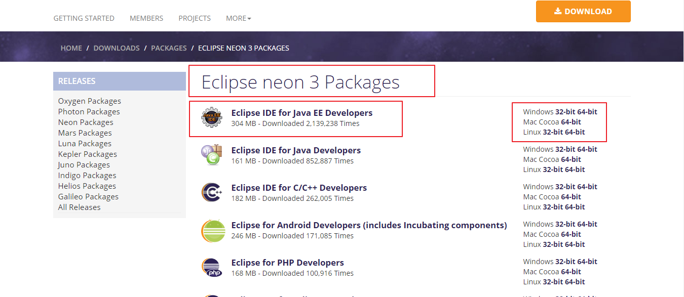
Set up Eclipse
Login to website address below and download Eclipse version neon 3 JAVA EEhttps://www.eclipse.org/downloads/packages/release/Neon/3

Slide 4
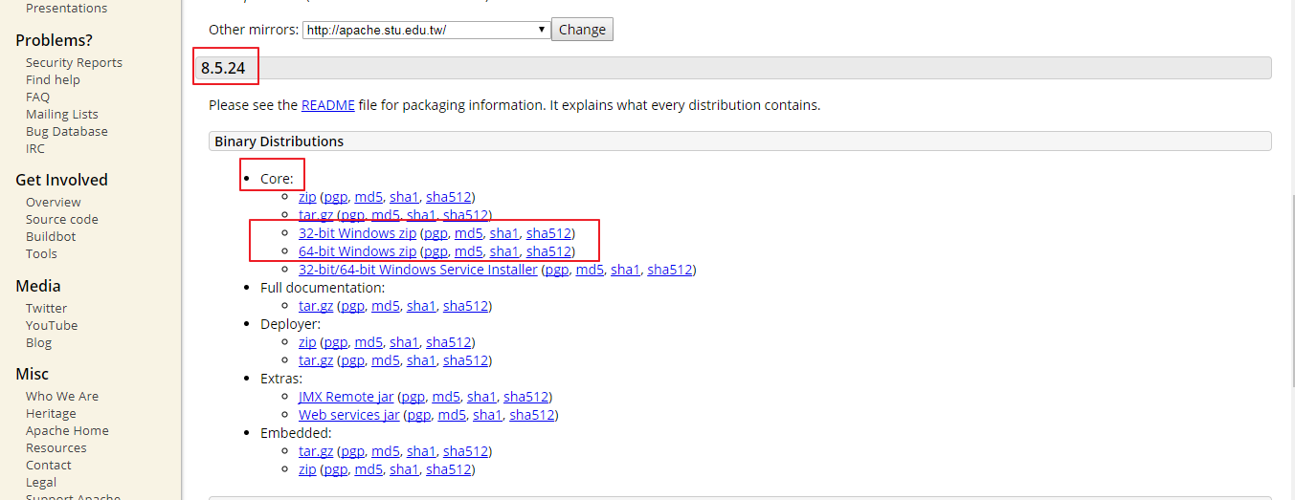
Set up Tomcat
Login to website address of Tomcat download Tomcat version 8.5.24
https://tomcat.apache.org/download-80.cgi

Slide 5
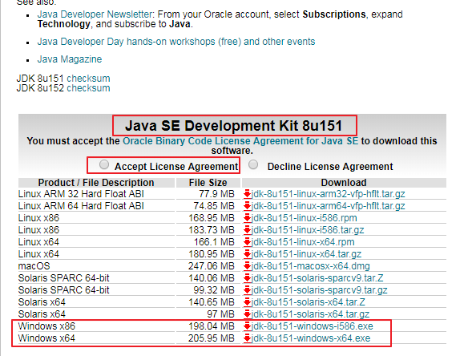
Set up JAVA JDK
Login to website address of JAVA download version JDK1.8.151 SE
http://www.oracle.com/technetwork/java/javase/downloads/jdk8-downloads-2133151.html

Slide 6
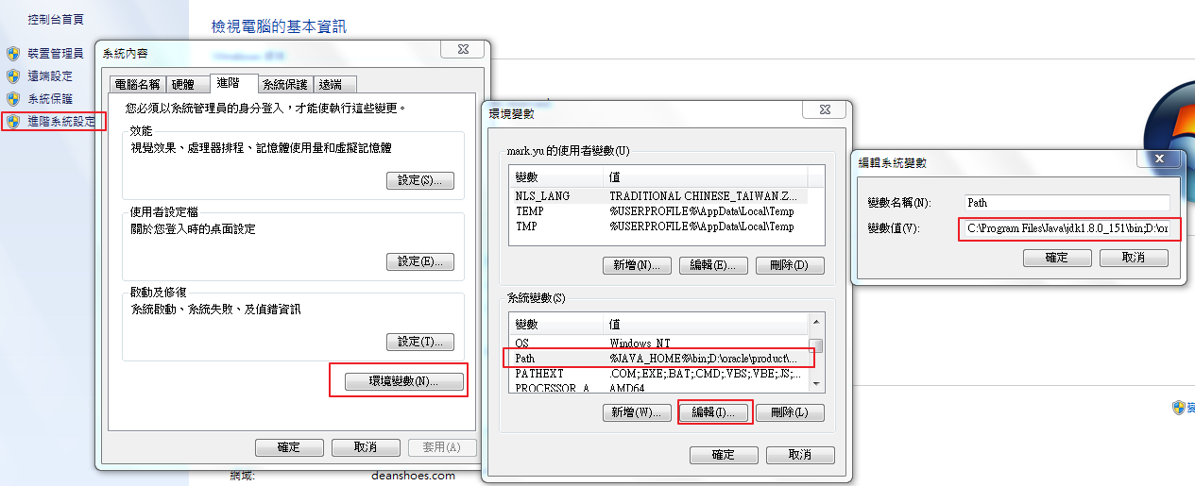
Settings of ENV parameter
Login to system, setting parameter scene, find the Path specifying the JDK link
C:\Program Files\Java\jdk1.8.0_151\bin;

Slide 7
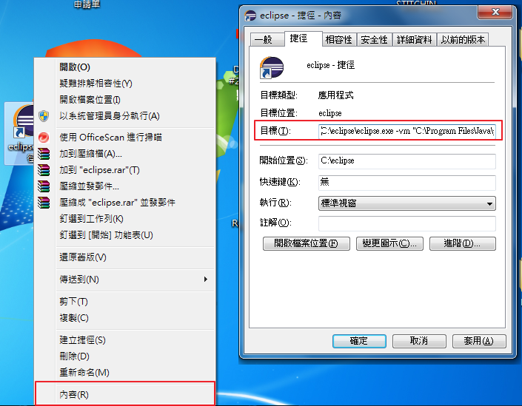
Settings of ENV parameter
2. If haven another version JDK and not want to modify, you can use this method:
Click right mouse Eclipse > content> purpose > the end of first link add link JDK set up JDK -vm "C:\Program Files\Java\jdk1.8.0_151\bin\javaw.exe;

Slide 8
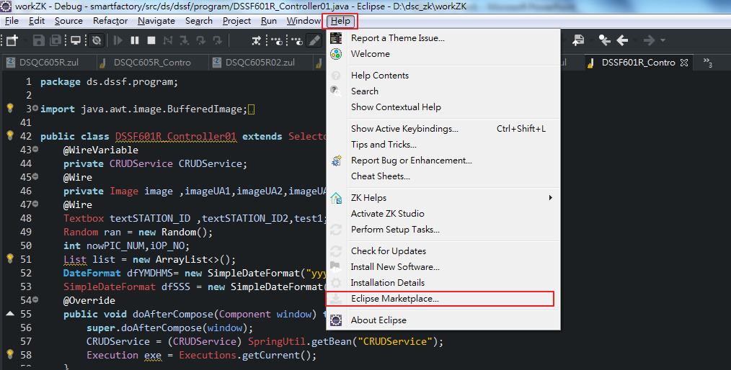
Setting Eclipse
Open Eclipse＞help＞Eclipse Marketplace

Slide 9
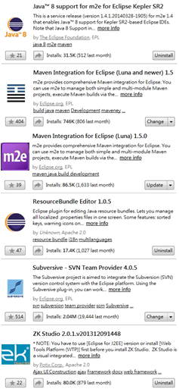
Setting Eclipse
Setting Eclipse like the picture on the right, step by step as below：
Java 8
Maven
ResourceBundle
SVN( may have or may not)
ZK

Slide 10
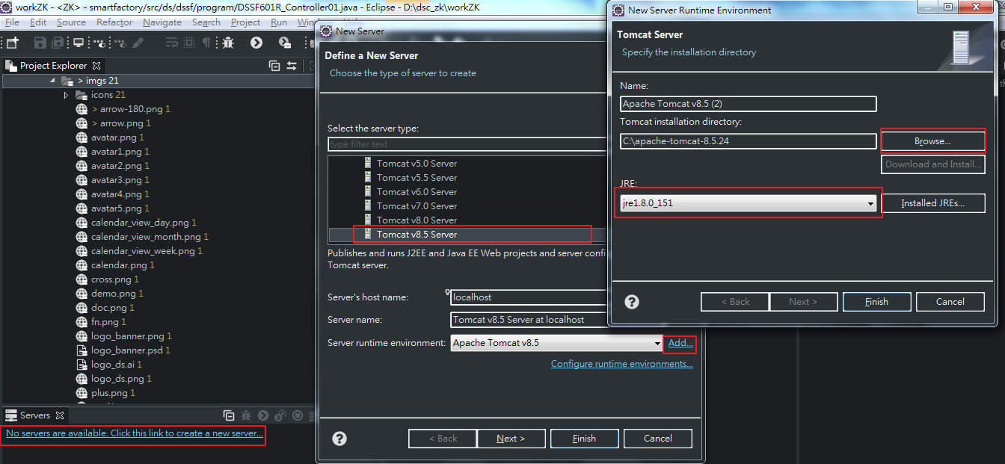
Setting Tomcat
2. Create Server> choose Tomcat 8.5>add>Browse choose Tomcat> choose jre1.8.0_151>Finish

Slide 11
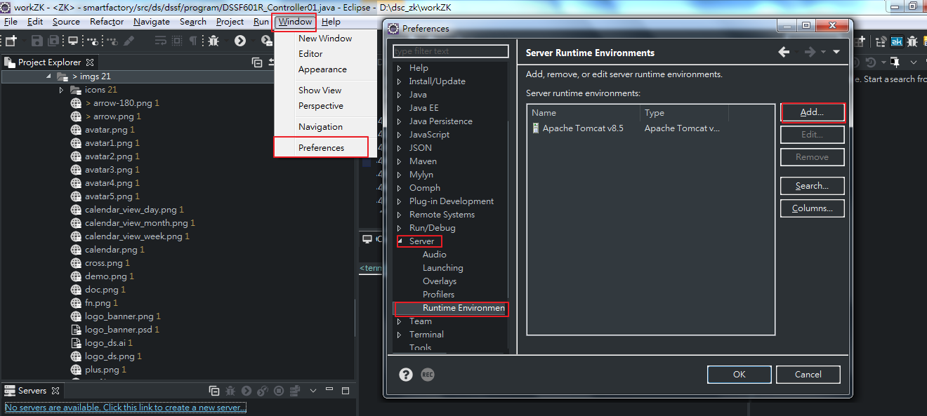
Setting Tomcat
1. Window>Preferences>Server>Runtime Environments>Add

Slide 12
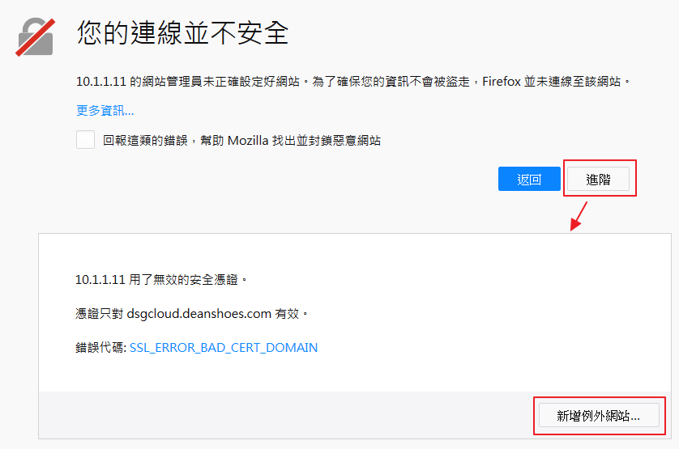
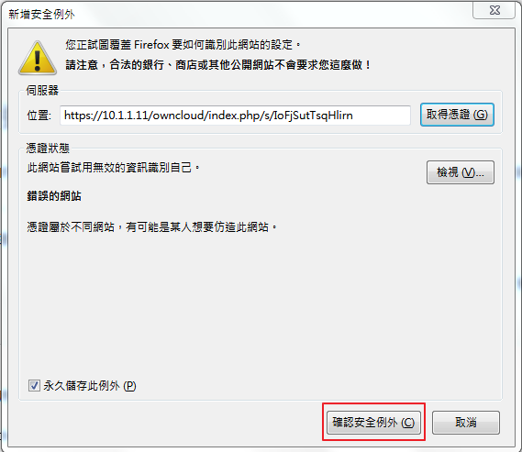
Zk-Platform
Empty Project of ZK , download from internal link below
cloud-based https://10.1.1.11/owncloud/index.php/s/IoFjSutTsqHlirn

Slide 13
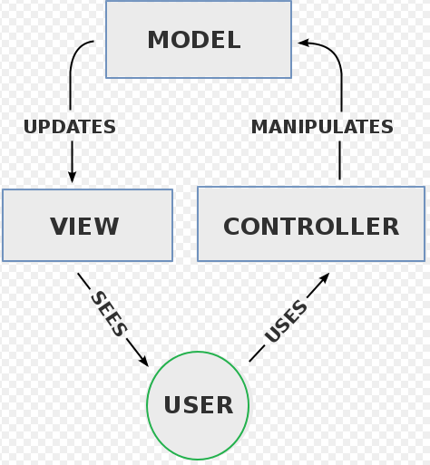
Structure of ZK
We will use structure MVC，create from zul(view)、java(controller)、domain(model)
MVC：split program to 3 element，Model（Model） -
View（View） -
Controller （Controller）design and define the interaction between them.

Slide 14
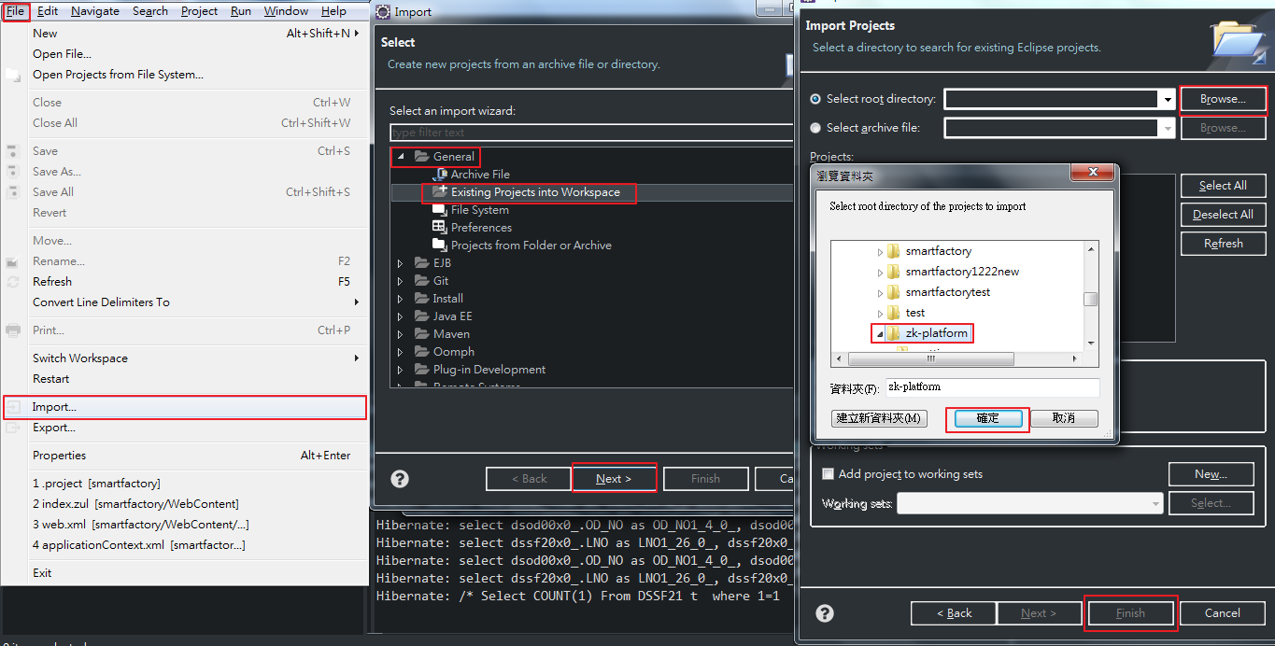
Create new Project
Dump into in project:
File＞Import＞General＞
Existing Projects into Workspace＞Next＞Browse＞choose project＞confirm＞Finish

Slide 15
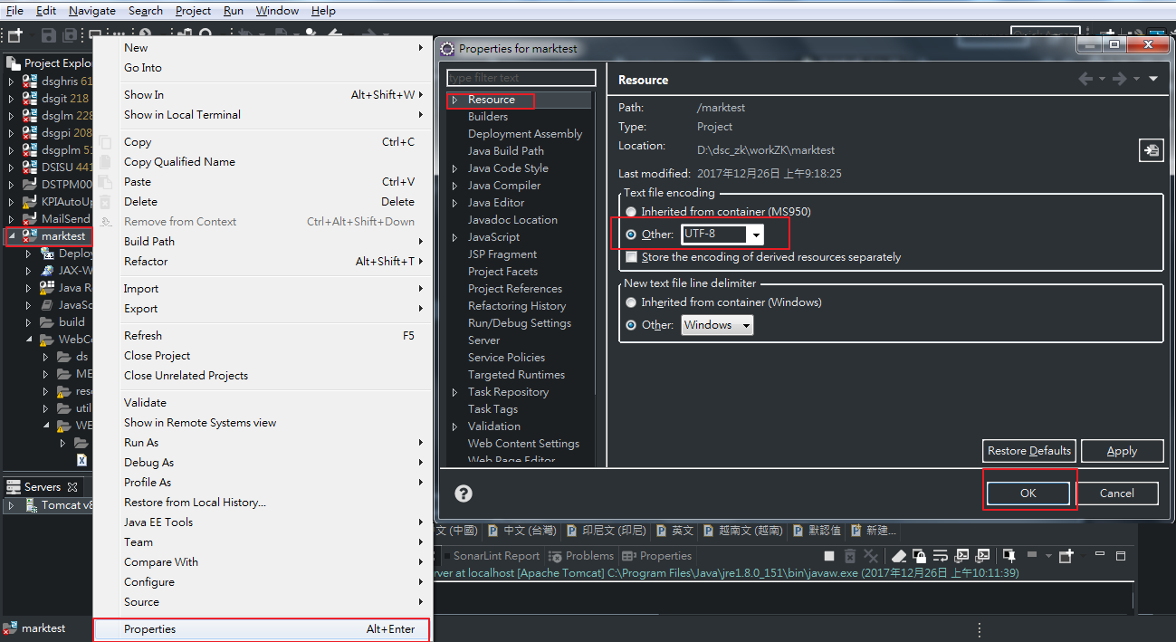
Create new Project
Modify the Unicode UTF-8, if not modify then the word not enough character：
Click the right mouse＞Propertis＞Resource＞UTF-8＞OK

Slide 16
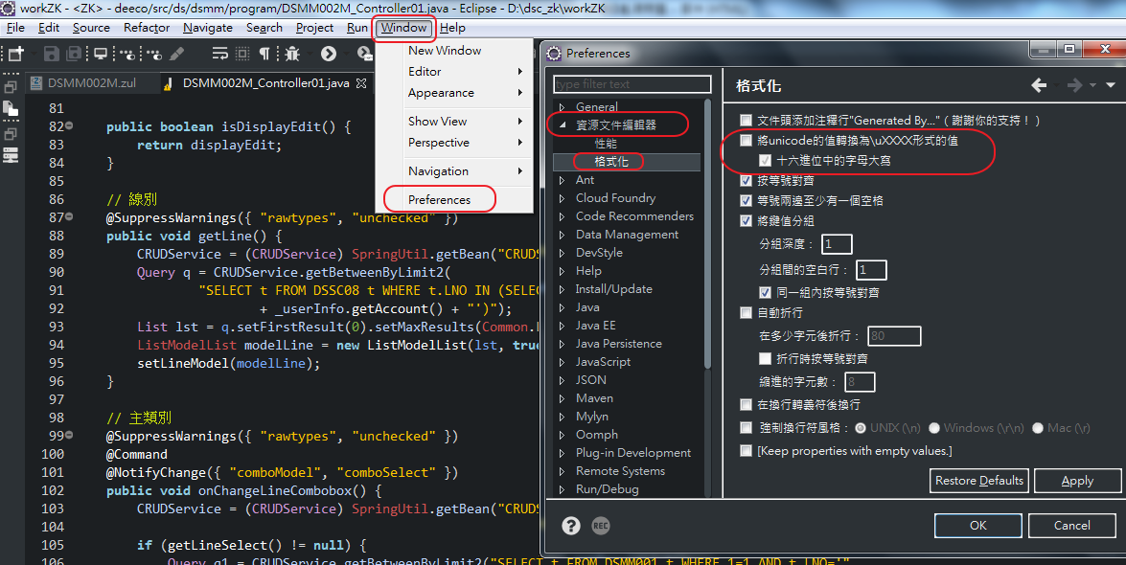
Create new Project
Close mode automatically change unicode：
Window＞Preferences＞packge modify original data＞format＞cancel auto change＞OK

Slide 17
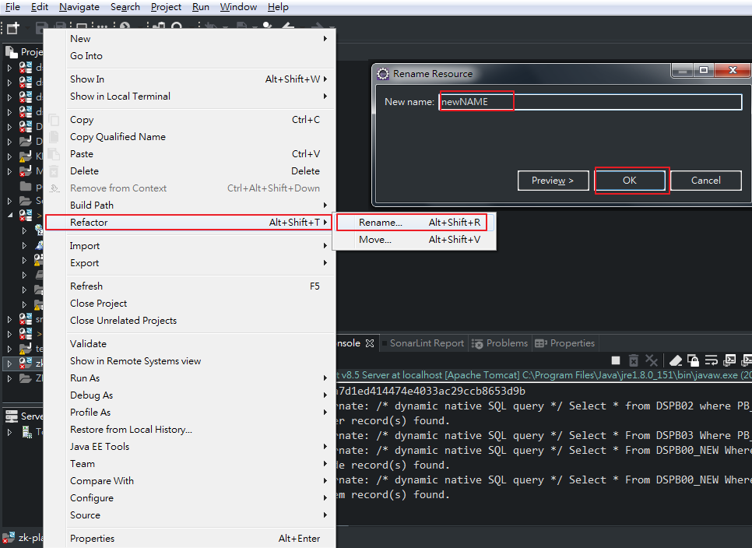
Create new Project
Modify name empty project：
Click right mouse＞Refactor＞Rename＞the new name＞OK

Slide 18
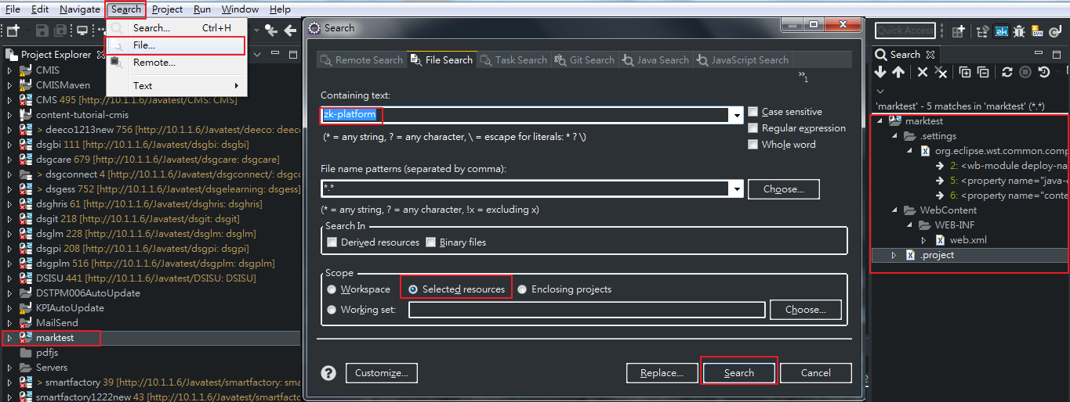
Create new Project
Change name of project：choose project>Search>File>seach zk-platform>Selected resources>Search>all program in List on the right have zk-platform must be modify to new project

Slide 19
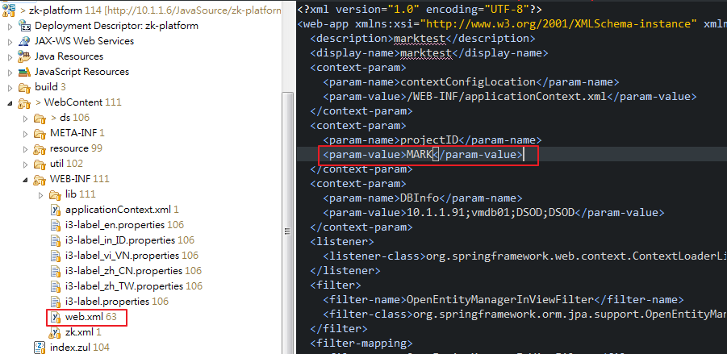
Create new Project
ProjectID of web.xml must be modify (length of character about 6)

Slide 20
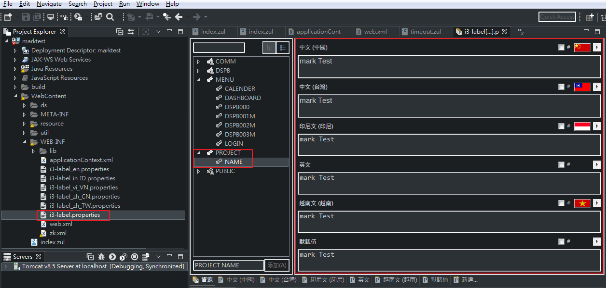
Create new Project
Modify Title of project：
i3-label.properties＞PROJECT＞NAME＞ZK Platform modify to the name of project

Slide 21

Create new Project
Use SQL as below： 8-1.Create permissions program DSPB01(if login has been had program then system will ignore) default account ADMIN
INSERT INTO DSPB01 (PB_USERID,PB_ID,PB_RH01,PB_RH02,PB_RH03,PB_RH04,PB_RH05,PB_RH06,PB_RH07,UP_USER)
VALUES ('DSGPI','{web.xml設定的projectID}_0001','Y','Y','Y','Y','Y','Y','Y','ADMIN');
INSERT INTO DSPB01 (PB_USERID,PB_ID,PB_RH01,PB_RH02,PB_RH03,PB_RH04,PB_RH05,PB_RH06,PB_RH07,UP_USER)
VALUES ('DSGPI','{web.xml設定的projectID}_0002','Y','Y','Y','Y','Y','Y','Y','ADMIN');
INSERT INTO DSPB01 (PB_USERID,PB_ID,PB_RH01,PB_RH02,PB_RH03,PB_RH04,PB_RH05,PB_RH06,PB_RH07,UP_USER)
VALUES ('DSGPI','{web.xml設定的projectID}_0003','Y','Y','Y','Y','Y','Y','Y','ADMIN');
INSERT INTO DSPB01 (PB_USERID,PB_ID,PB_RH01,PB_RH02,PB_RH03,PB_RH04,PB_RH05,PB_RH06,PB_RH07,UP_USER)
VALUES ('DSGPI','{web.xml設定的projectID}_0004','Y','Y','Y','Y','Y','Y','Y','ADMIN');
{web.xml設定的projectID} please modify by yourself the content in the red boder like this picture

Slide 22
Create new Project
8-2.Create permissions program DSPB01(if login has been had program then system will ignore)
INSERT INTO DSPB00_NEW (PB_NO,PB_SYSID,PB_ID,PB_LANGTAG,PB_MUNODE,PB_MUITEM,PB_FILEPATH,PB_ADMIN,UP_USER,UP_DATE,PB_PRGNAME,PB_ICONSCLASS)
VALUES ('0001','{web.xml設定的projectID}','{web.xml設定的projectID}_0001','MENU.DSPB000','','00','','Y','ADMIN',TO_DATE('2017/12/26','YYYY/MM/DD'),'','z-icon-angle-double-right');
INSERT INTO DSPB00_NEW (PB_NO,PB_SYSID,PB_ID,PB_LANGTAG,PB_MUNODE,PB_MUITEM,PB_FILEPATH,PB_ADMIN,UP_USER,UP_DATE,PB_PRGNAME,PB_ICONSCLASS)
VALUES ('0002','{web.xml設定的projectID}','{web.xml設定的projectID}_0002','MENU.DSPB001M','00','01','/ds/dspb/DSPB001M.zul','Y','ADMIN',TO_DATE('2017/12/26','YYYY/MM/DD'),'DSPB001M_Controller01','z-icon-angle-double-right');
INSERT INTO DSPB00_NEW (PB_NO,PB_SYSID,PB_ID,PB_LANGTAG,PB_MUNODE,PB_MUITEM,PB_FILEPATH,PB_ADMIN,UP_USER,UP_DATE,PB_PRGNAME,PB_ICONSCLASS)
VALUES ('0003','{web.xml設定的projectID}','{web.xml設定的projectID}_0003','MENU.DSPB002M','00','02','/ds/dspb/DSPB002M.zul','Y','ADMIN',TO_DATE('2017/12/26','YYYY/MM/DD'),'DSPB002M_Controller01','z-icon-angle-double-right');
INSERT INTO DSPB00_NEW (PB_NO,PB_SYSID,PB_ID,PB_LANGTAG,PB_MUNODE,PB_MUITEM,PB_FILEPATH,PB_ADMIN,UP_USER,UP_DATE,PB_PRGNAME,PB_ICONSCLASS)
VALUES ('0004','{web.xml設定的projectID}','{web.xml設定的projectID}_0004','MENU.DSPB003M','00','03','/ds/dspb/DSPB003M.zul','Y','ADMIN',TO_DATE('2017/12/26','YYYY/MM/DD'),'DSPB003M_Controller01','z-icon-angle-double-right');

Slide 23
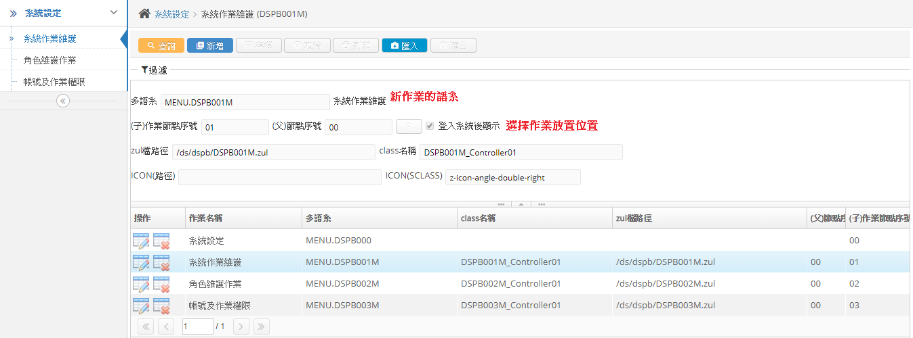
System Setting
How to maintenance and use the program of system ：
Should put the program at the right of choose list to setting
Notes:
System settings

Slide 24
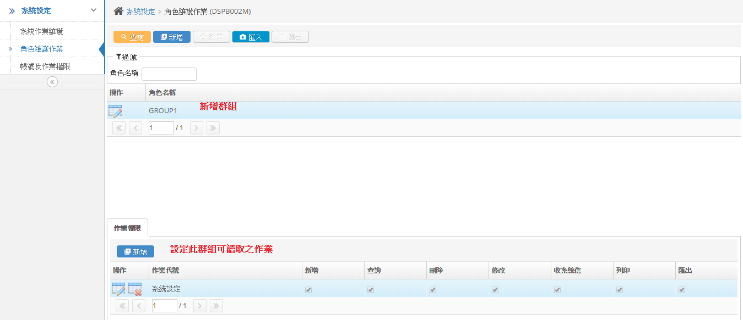
System Setting
Maintenance role program：
Setting permission of program to a group
Notes:
System settings

Slide 25
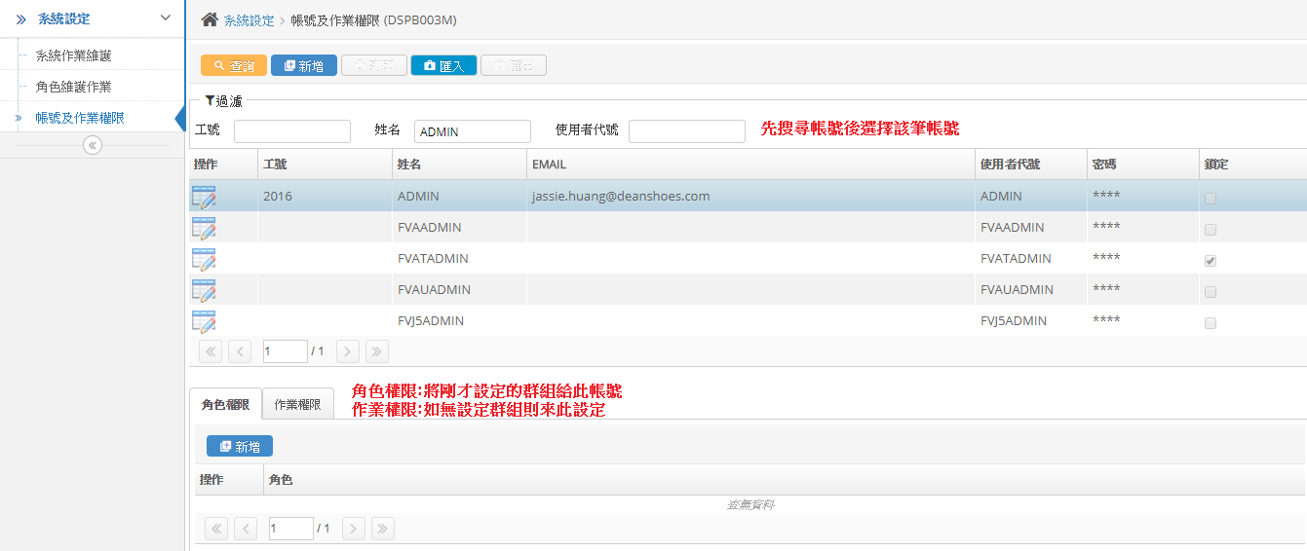
System Setting
Account and permission of program
Setting permission of program for an any account
Notes:
System settings

Slide 26
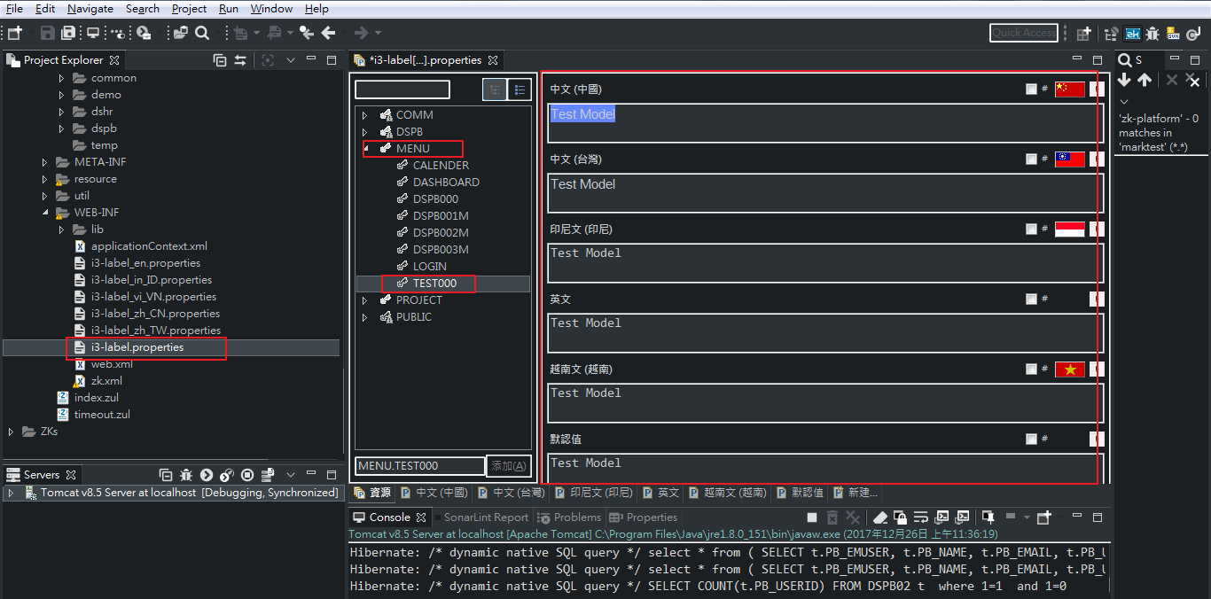
Create the first program
Create new module :i3-label.properties>MENU>NAME> name module
Notes:
Create the first program

Slide 27
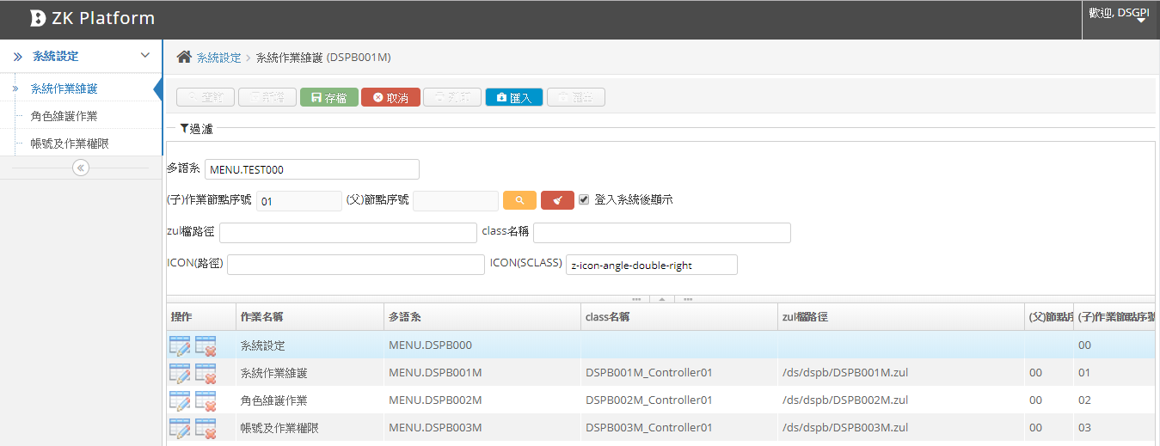
Create the first program
Login to setting the program>module has been created from that program maintenance system>add new>save file

Slide 28
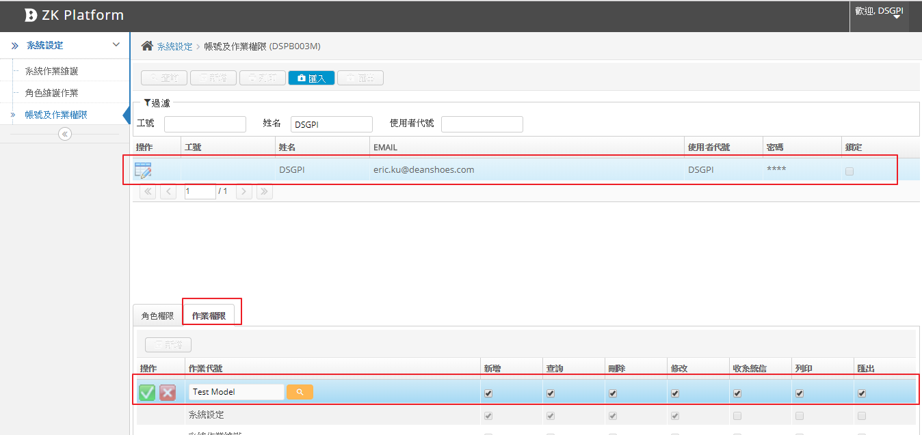
Create the first program
Login to setting the program＞account and permission of program＞query account DSGPI
＞set permission for this account

Slide 29
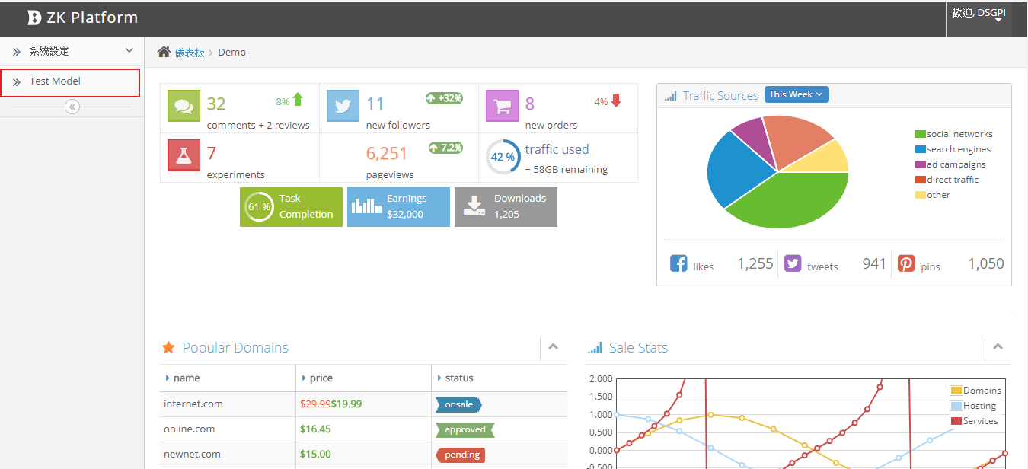
Create the first program
Result：the menu on the left will be have new module just create

Slide 30
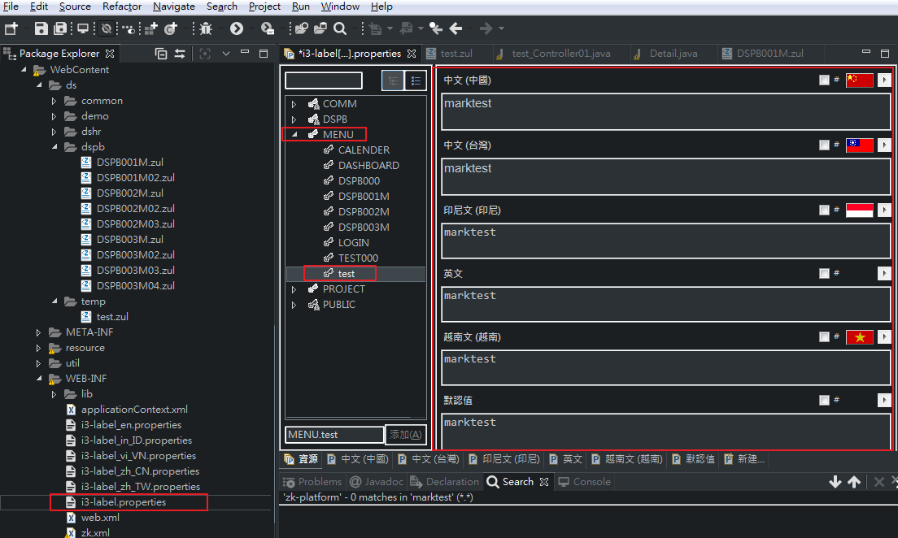
Create the first project
Create new language for program：
i3-label.properties＞MENU＞NAME＞name of program

Slide 31
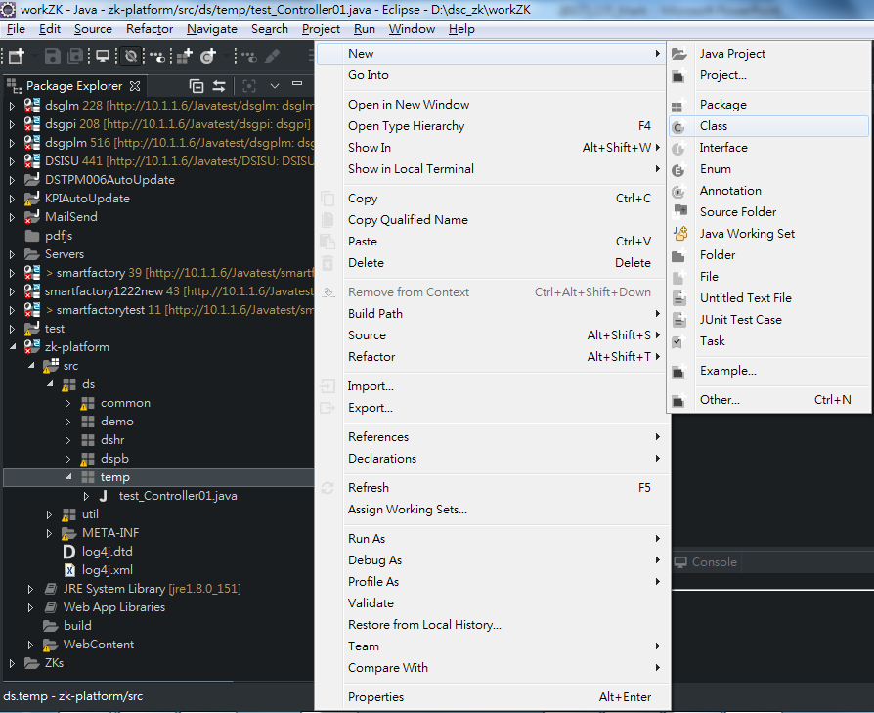
Create the first program
Create a file with data test underJava Resources/src/ds：
Click right mouse ＞New＞Class

Slide 32
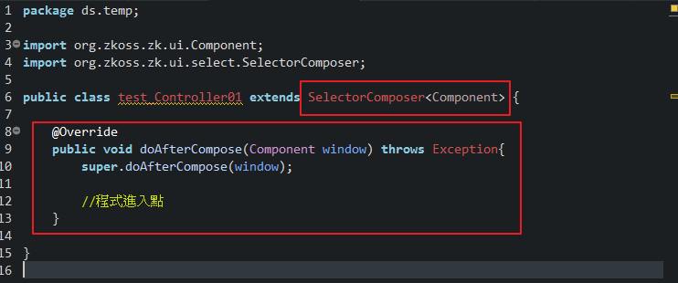
Create the first program
Exttends SelectorComposer<Component>(Zk parent)
Write a loop doAfterCompose (điểm vào chương trình ZK)

Slide 33
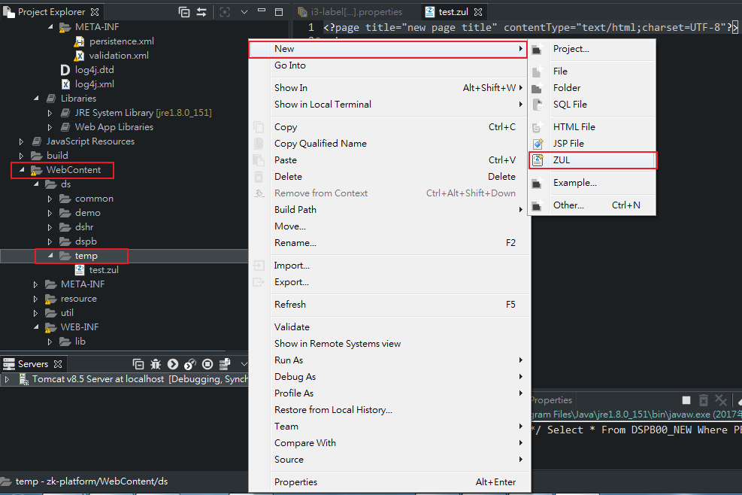
Create the first program
Create a file with data test under WebContent/ds：
Click right mouse>New>ZUL

Slide 34
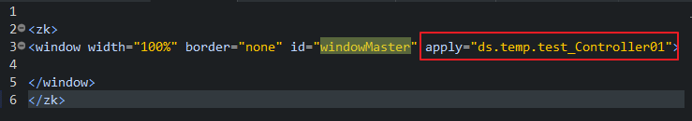
Create the first program
In Window constraints java just create

Slide 35
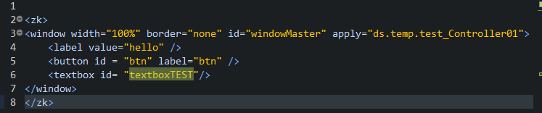
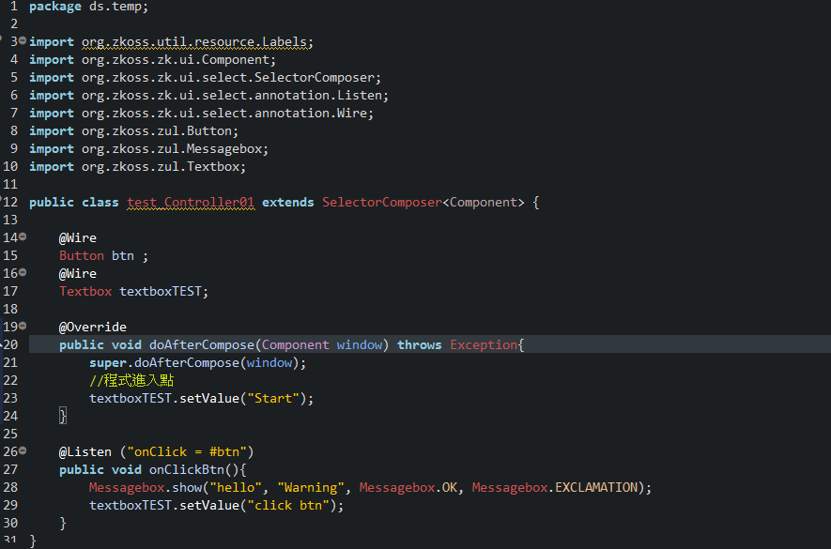
Create the first program
Create element, each element give id to do will be call at constraints in java
zul
java

Slide 36
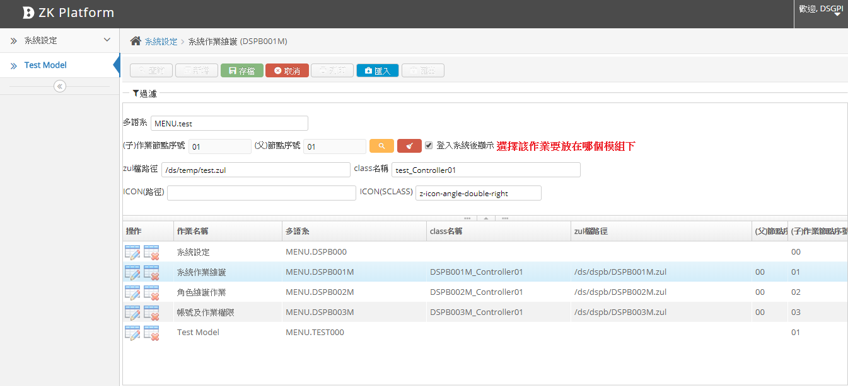
Create the first program
Provides this program permissions for account
Login to setting system＞that program have been created from maintenance system program＞create new＞save file

Slide 37
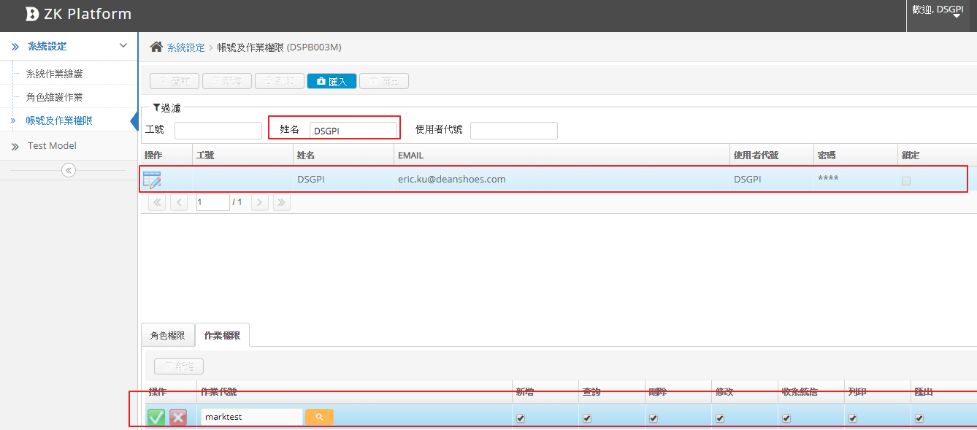
Create the first program
Provides this program permissions for account :
Login to setting system＞account and permission program＞query account DSGPI
＞set permission program for this account

Slide 38
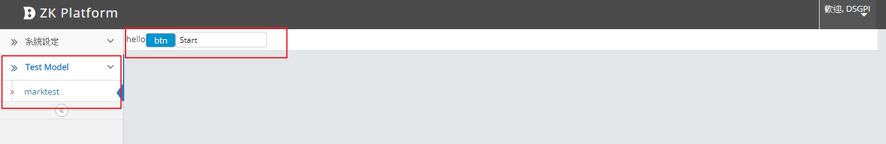
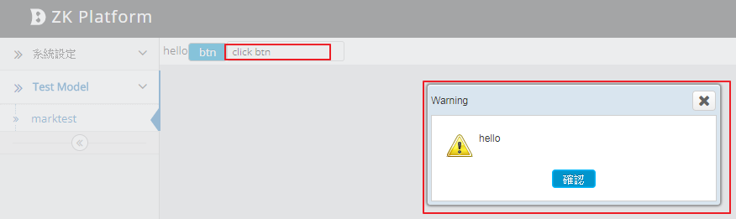
Create the first program
Result
Click button

Slide 39
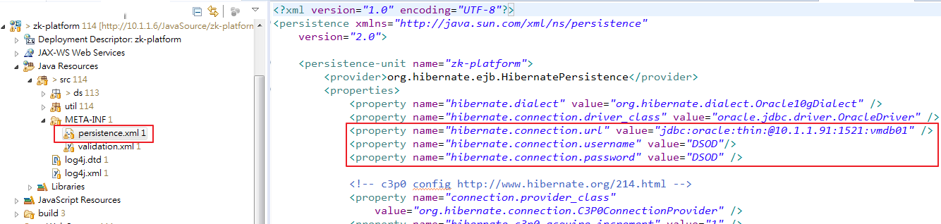
persistence.xml
File setting connect database to project, when start program, hibernate will come here for get connect.
hibernate.connection.url ->link ip
hibernate.connection.username ->account
hibernate.connection.password ->password

Slide 40

web.xml
Use when need to individual link to another database
param-name -> set name by yourseft
param-value ->format:IP;DB; account;password
Use :””inside is param-name

Slide 41
Blackbox.java
Location put program use general (downline can’t modify)

Slide 42
Common.java
Location put program use general(for project, you can create new)

Slide 43


Binding with element of ZK
In file zul, we will give to elements ID, in file java can use @Wire to constraints element file zul, have event listen @Listen
.zul
.java

Slide 44
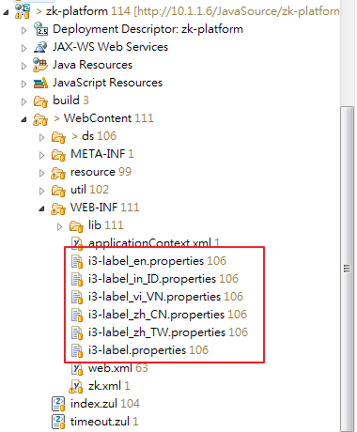
Multiple languages
If need to use multiple languages, as below picture：
Location of file language

Slide 45
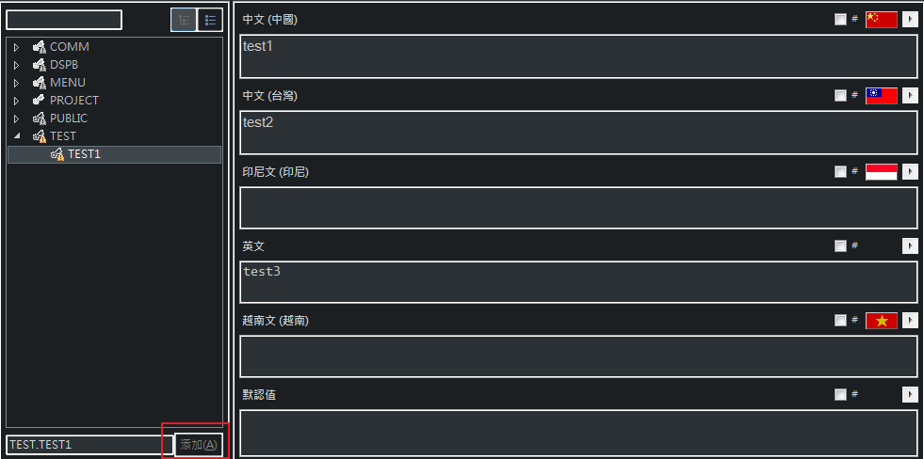
Multiple language
If need to use multiple languages, as below picture:
Create new language

Slide 46
Multiple language
If need to use multiple languages, as below picture:
.zul
.java

